Slide 1
SQL Server Data Tools
Lecturer: Ngo Huy Bien
Software Engineering Department
Faculty of Information Technology
VNUHCM - University of Science
Ho Chi Minh City, Vietnam
nhbien@fit.hcmus.edu.vn

Slide 2

Objectives
To use SQL Server Data Tools to develop a software application.

Slide 3

Contents

Slide 4

References

Slide 5
SQL Server Data Tools
https://docs.microsoft.com/en-us/sql/ssdt/download-sql-server-data-tools-ssdt
SQL Server Data Tools (SSDT) is a modern development tool for building SQL Server relational databases, databases in Azure SQL, Analysis Services (AS) data models, Integration Services (IS) packages, and Reporting Services (RS) reports.
With SSDT, you can design and deploy any SQL Server content type with the same ease as you would develop an application in Visual Studio.

Slide 6
Previous Releases of SQL Server Data Tools
https://docs.microsoft.com/en-us/sql/ssdt/previous-releases-of-sql-server-data-tools-ssdt-and-ssdt-bi
SQL Server Data Tools (SSDT) provides project templates and design surfaces for building SQL Server content types - relational databases, Analysis Services models, Reporting Services reports, and Integration Services packages.
SSDT is backwards compatible, so you can always use the newest SSDT to design and deploy databases, models, reports, and packages that run on older versions of SQL Server.
Historically, the Visual Studio shell used to create SQL Server content types has been released under various names, including SQL Server Data Tools, SQL Server Data Tools - Business Intelligence, and Business Intelligence Development Studio.

Slide 7
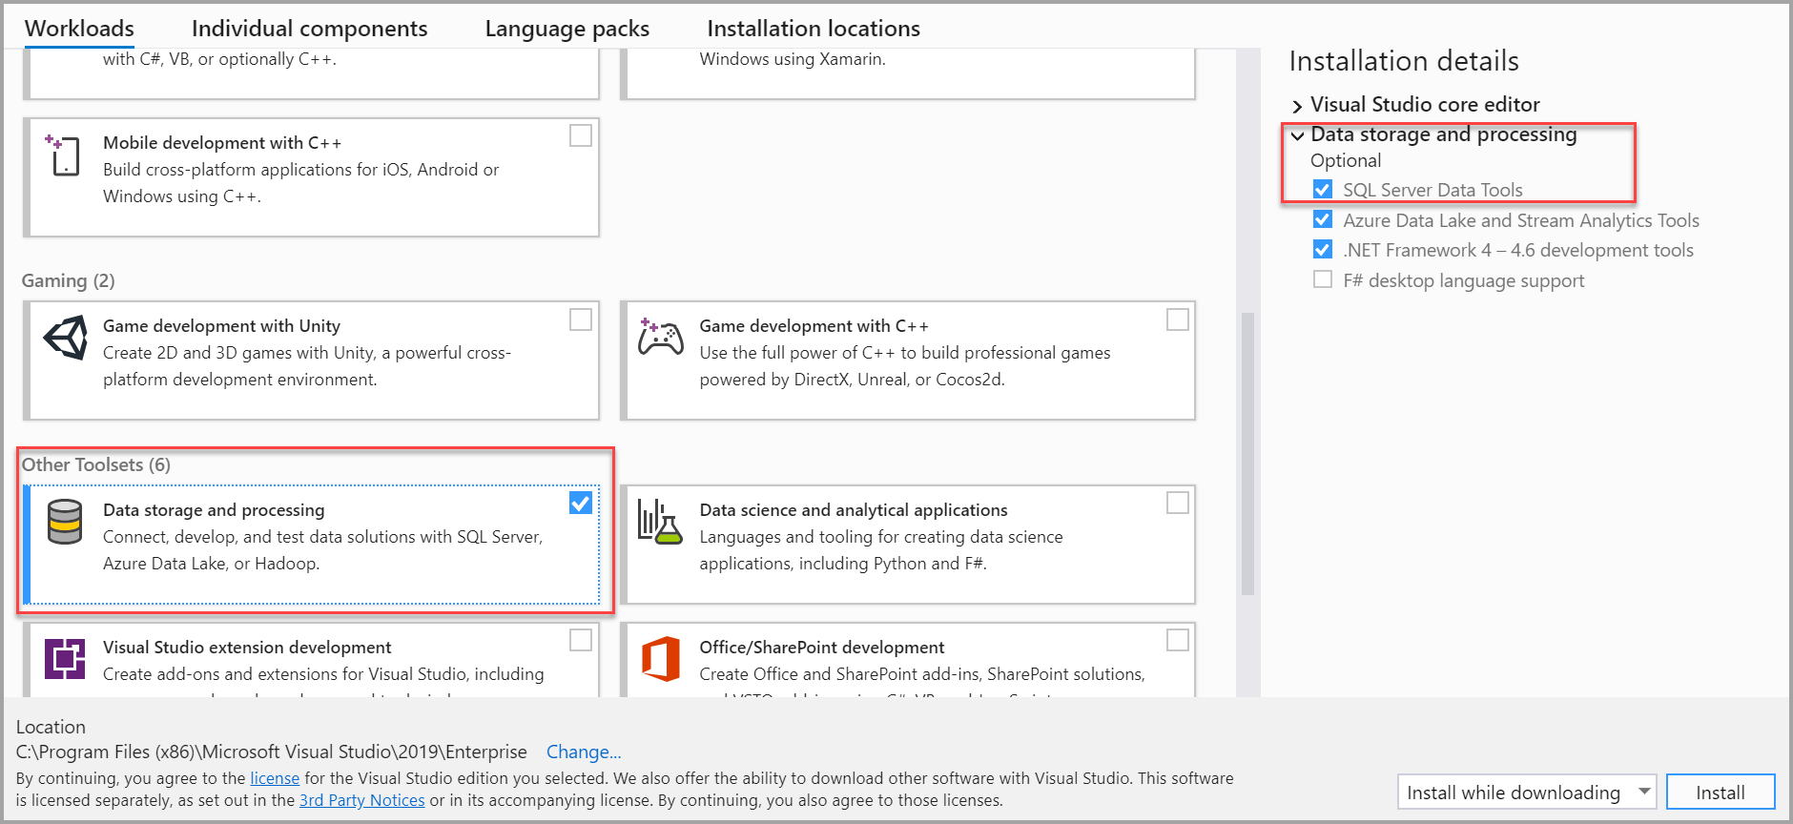
Install SSDT with Visual Studio 2019

Slide 8
Database Delivery
https://samirbehara.com/2018/04/16/database-delivery-state-based-vs-migration-based/
For database development and deployment there are primarily 2 delivery mechanisms — State based and Migration based approach.

Slide 9
State Based Approach
In State based database delivery, you will need to store a snapshot of the current state of the database in your source control.
Every table, stored procedure, view, trigger will be saved as separate sql files which will be the real representation of the state of your database objects.
When you want to modify the database schema or reference data, all you need to do is explicitly mention the expected database state.
The Compare Tool does all the magic and generates the difference script which then gets executed against the database.

Slide 10
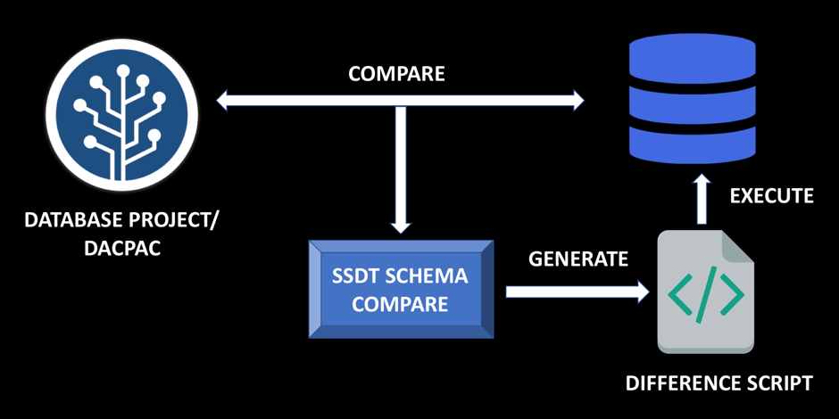
State Based Approach Implementation
The most important thing to note is that in State based approach the system of truth is the Source Code itself.
If you want to implement State based approach, you can go with Database Projects in Visual Studio which uses SQL Server Data Tools.

Slide 11
Migration Based Approach
In Migration Based Database Delivery, when you start working on a project you capture the current state of the database in a single migration script stored inside source control and that becomes the base/initial state.
As the project evolves over time, you will need to make changes to your database schema and reference data.
On every instance, you will need to create a migration script with an incremental version number. If you want to determine the current state of your database or recreate the database in another environment, you will need to run all the migration scripts in the correct order.

Slide 12
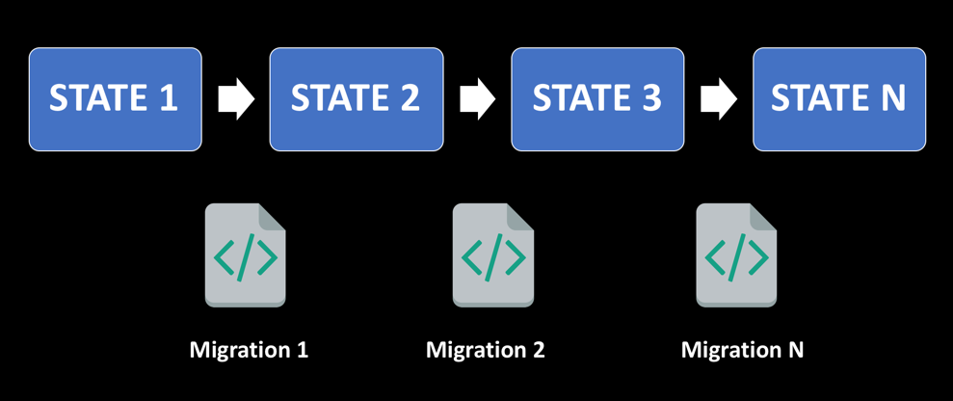
Migration Based Approach Implementation
The system of truth in Migration based approach is the Database itself.
If you want to implement Migration based approach, you can go with RedGate ReadyRoll. You can also go with Flyway.

Slide 13
More about Database Delivery
https://www.martinfowler.com/articles/evodb.html

Slide 14
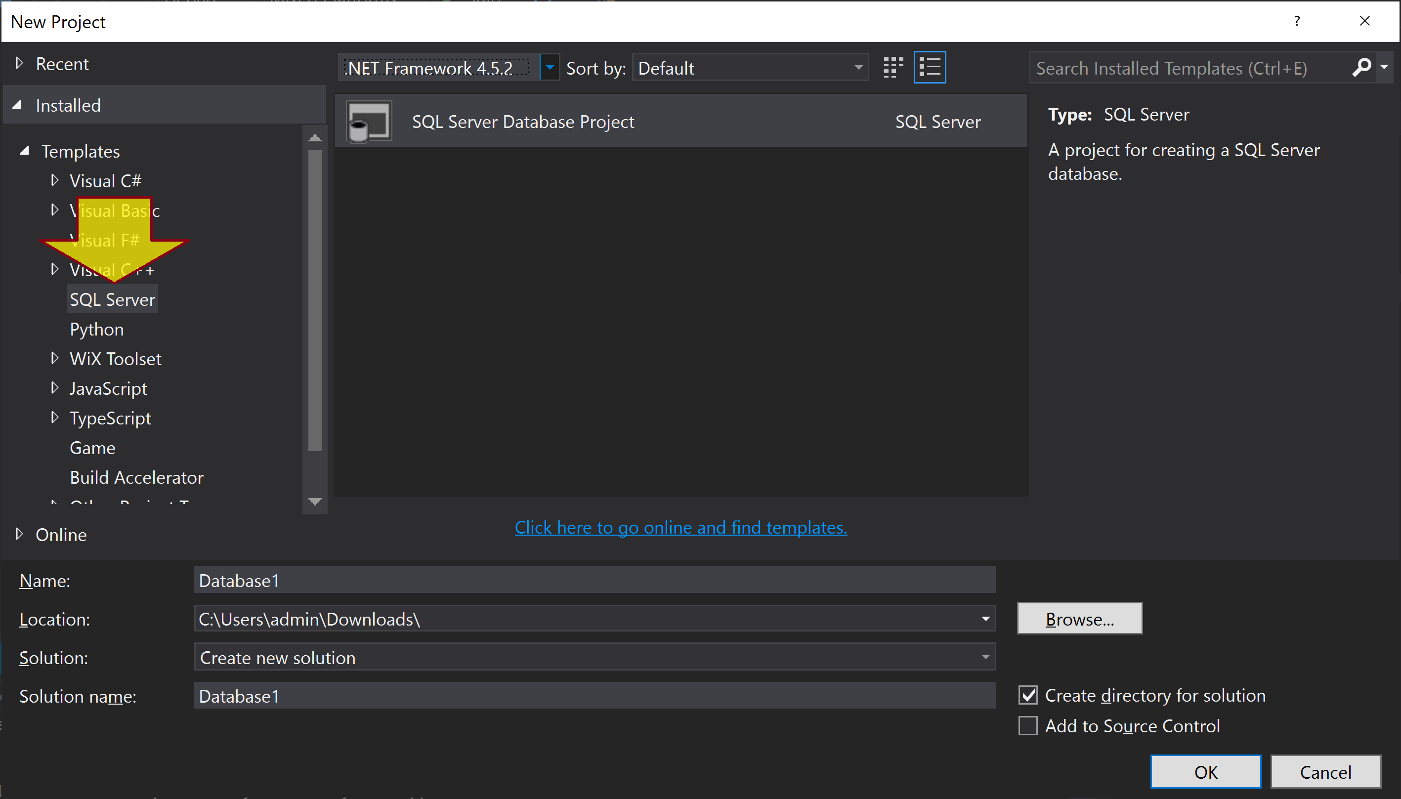
Create a Database Project

Slide 15
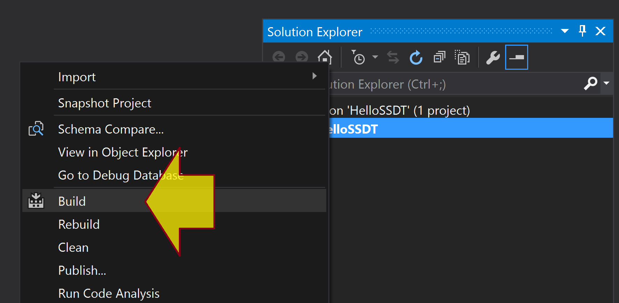
Build a Database Project
Build is roughly analogous to "will the code compile", e.g. is the syntax good, or are you referencing tables, columns, procedure that don't exist.
As it's managed in Visual Studio, tracking down and fixing those bugs can be very easy.

Slide 16
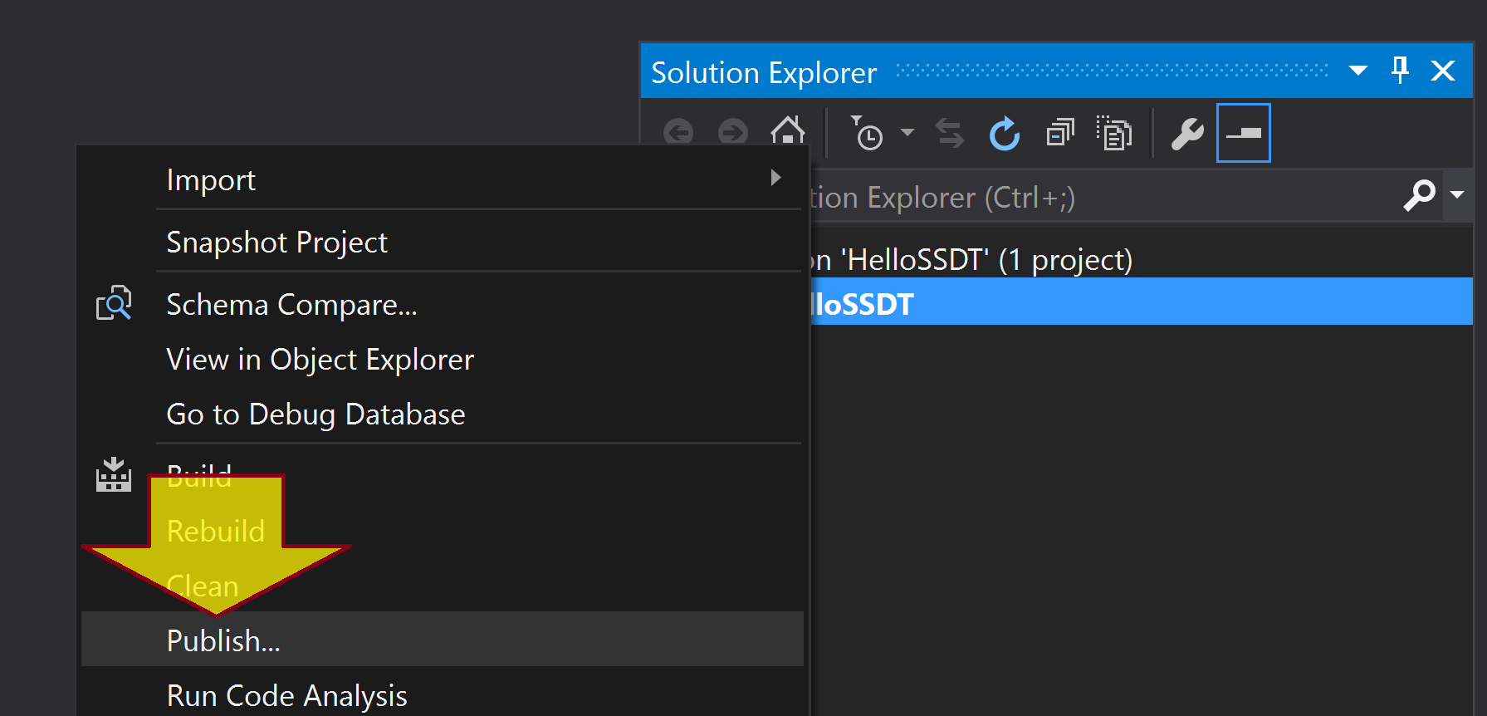
Publish a Database Project
Publish is, essentially, "take the database as defined in the code in this project, compare it with a target database, and make that database look like what we have in code".
You feed the (table, procedure, etc.) definitions in, SSDT will write all of the necessary CREATE, ALTER, and DROP statements for you.

Slide 17
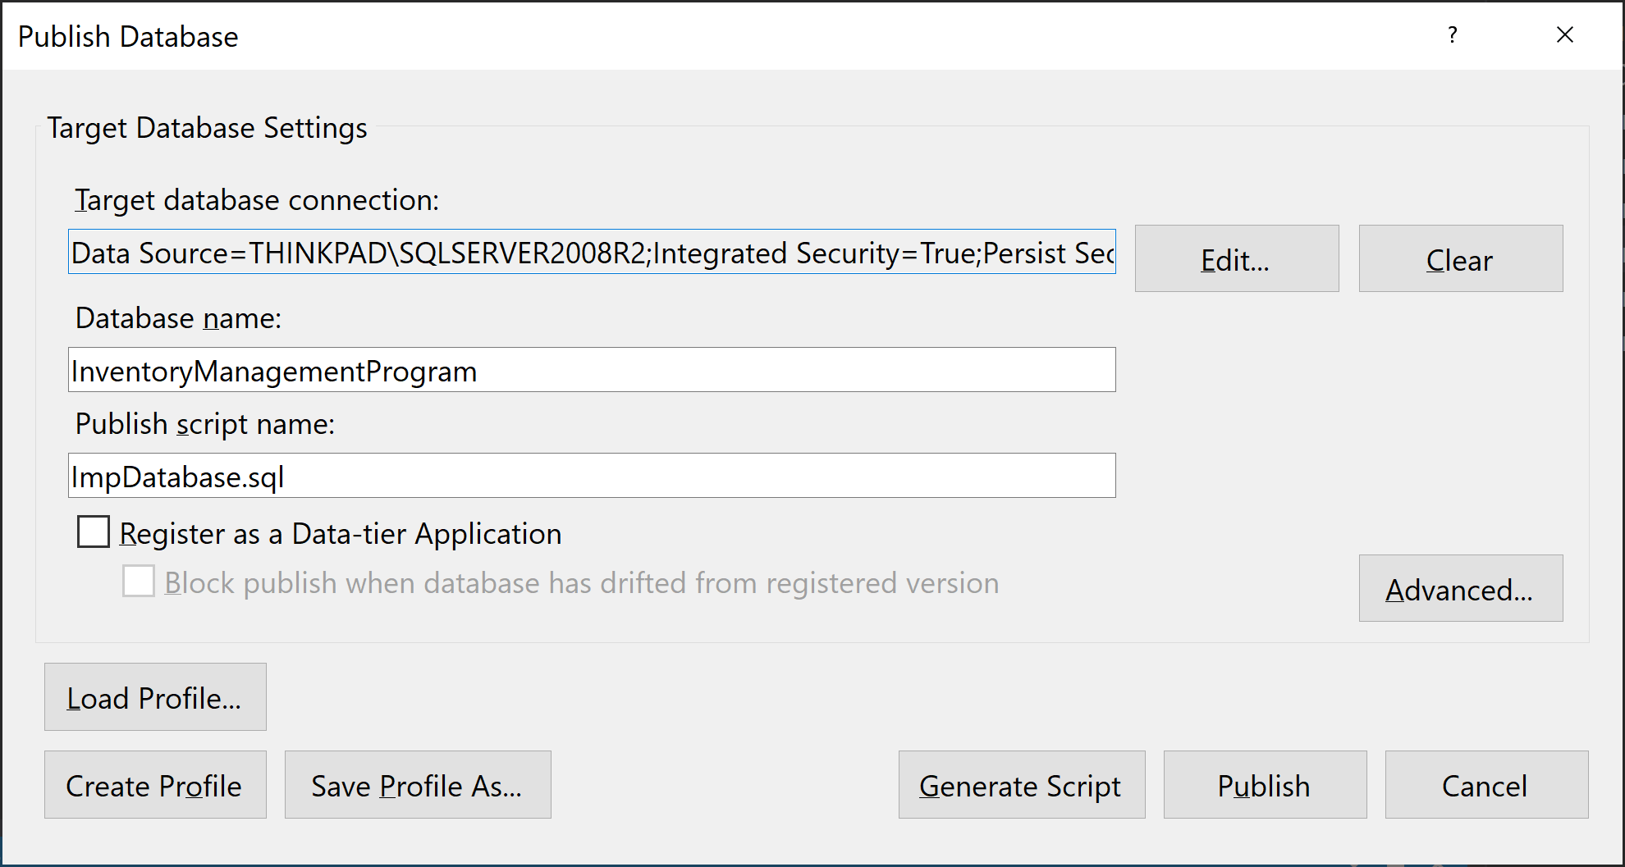
Publish a Database Project

Slide 18


Slide 19
Data-Tier Applications
A data-tier application (DAC) is a logical database management entity that defines all of the SQL Server objects - like tables, views, and instance objects, including logins - associated with a user's database.
A DAC is a self-contained unit of SQL Server database deployment that enables data-tier developers and database administrators to package SQL Server objects into a portable artifact called a DAC package, also known as a DACPAC, or .dacpac file.
A DACPAC is a Windows file with a .dacpac extension.

Slide 20
DAC Tools
In general, DAC tools are capable of reading DACPAC files generated by DAC tools from previous SQL Server versions, and can also deploy DACPACs to previous versions of SQL Server.
However, DAC tools from earlier versions cannot read DACPAC files generated by DAC tools from later versions.

Slide 21
DAC Operations
A DAC supports the following operations:
EXTRACT - the user can extract a database into a DACPAC.
DEPLOY - the user can deploy a DACPAC to a host server. When the deployment is done from a manageability tool like SQL Server Management Studio or the Azure portal, the resulting database in the host server is implicitly registered as a data-tier application.
REGISTER - the user can register a database as a data-tier application.
UNREGISTER - a database previously registered as a DAC can be unregistered.
UPGRADE - a database can be upgraded using a DACPAC. Upgrade is supported even on databases that are not previously registered as data-tier applications, but as a consequence of the upgrade, the database will be implicitly registered.

Slide 22

Thank You & See You Again

